Slide 1
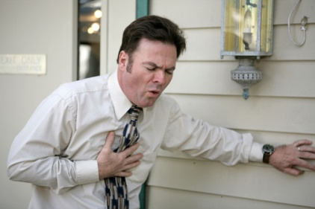
Predicting CardioVascular Disease in Framingham, MA
Final Group Project 4
Members: Chris Sharber, Alex Gorbulin, Aida Ndiongue, Rocky Owens

